Slide 2
Deep reinforcement learning control for deformable object manipulation
Project Motivation
Lateset Progress
Improvement
Implement
Schedule

Slide 3
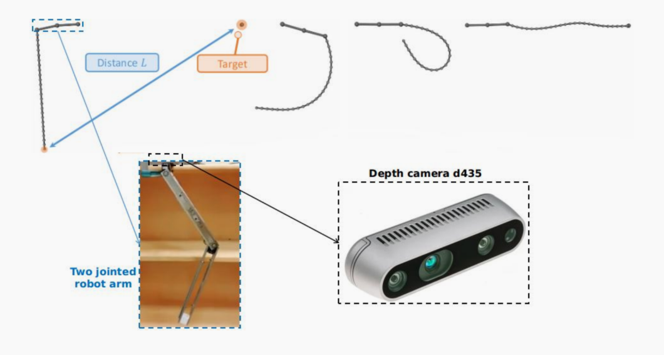
Deep reinforcement learning control for deformable object manipulation
Project Motivation
Depends on different positions of targets, controlling the deformable things to hit them through the two-jointed arm

Slide 4
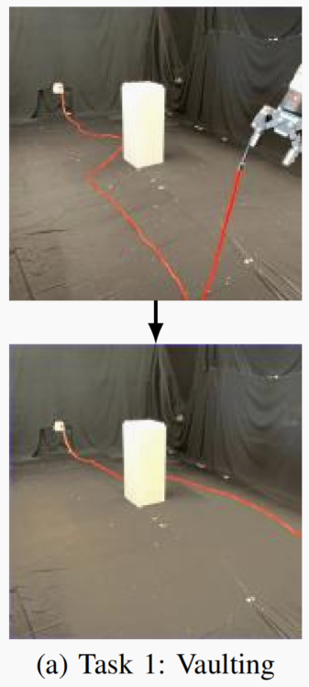
Deep reinforcement learning control for deformable object manipulation
Latest Progress
For the Harry Zhang research(Self-Supervised Learning to Dynamically Manipulate
Fixed-Endpoint Cables), using deep learning to train his policy can get 81.7% accurancy in vaulting movement

Slide 5
Deep reinforcement learning control for deformable object manipulation
Improvement & Implement
only one fixed rope end
train a policy to hit different targets
more accuracy
How to do
1. Make assumptions at first
2. Find a policy for the rope dynamic manipulation
3.Collect the dataset and images process
4. Deep learning to train the policy
5. Simulate the policy in Blender and Bullet Physics(3D creation suit) get proper hyperparms
6.Physics experiment

Slide 6
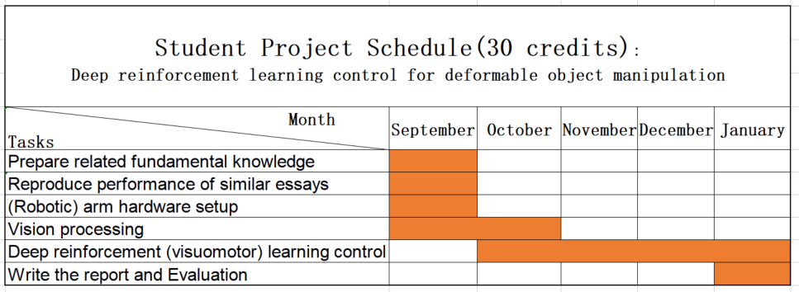
Deep reinforcement learning control for deformable object manipulation
Project Schedule

Slide 7
Thanks!

